Slide 1

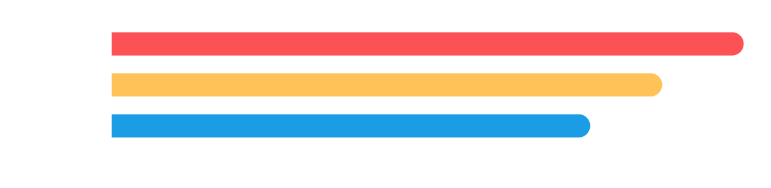
Reports and Dashboards in Salesforce
Independent Project: Use Salesforce to Create Reports and Dashboards
Basanta Gurung

Slide 2
Project
Overview
1
Task 1: Create a Tabular Report
2
Task 2: Create a Summary Report
3
Task 3: Create a Matrix Report
4
Task 4: Business Case Analysis

Slide 3
Project
Overview
5
Task 5: Create a New Report
6
Task 6: Create Report Charts
7
Task 7: Create a Dashboard

Slide 4
Task 1: Create a Tabular Report
On the following slide, insert a screenshot of the tabular report you just created and ran.

Slide 5

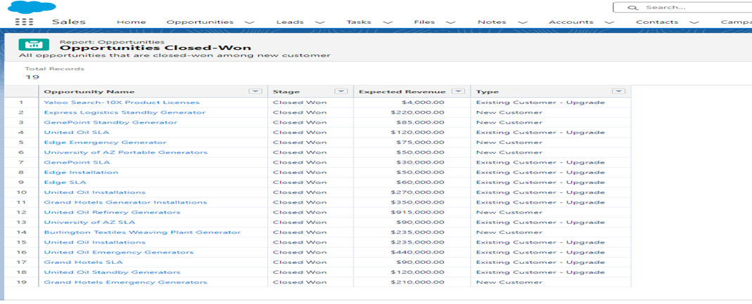
Task 1: Create a Tabular Report
Opportunities Closed-Won

Slide 6
Task 2: Create a Summary Report
On the following slide, insert a screenshot of the summary report you just created and ran.

Slide 7
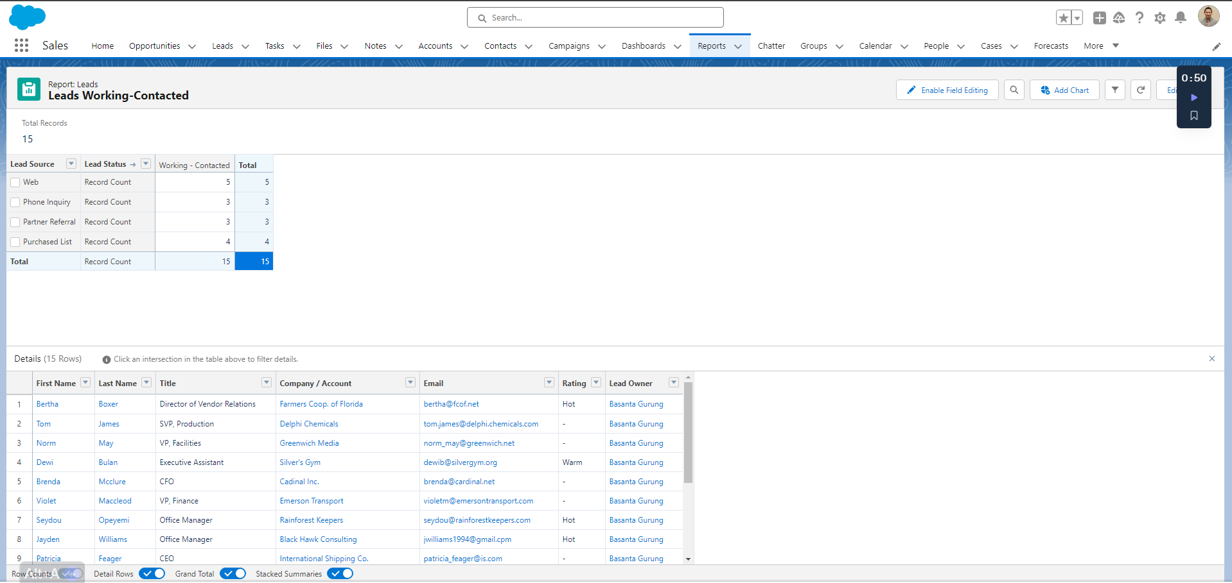
Task 2: Create a Summary Report
Leads Working-Contacted
Insert Task 2 screenshot here.

Slide 8
Task 3: Create a Matrix Report
On the following slide, insert a screenshot of the matrix report you just created and ran.

Slide 9

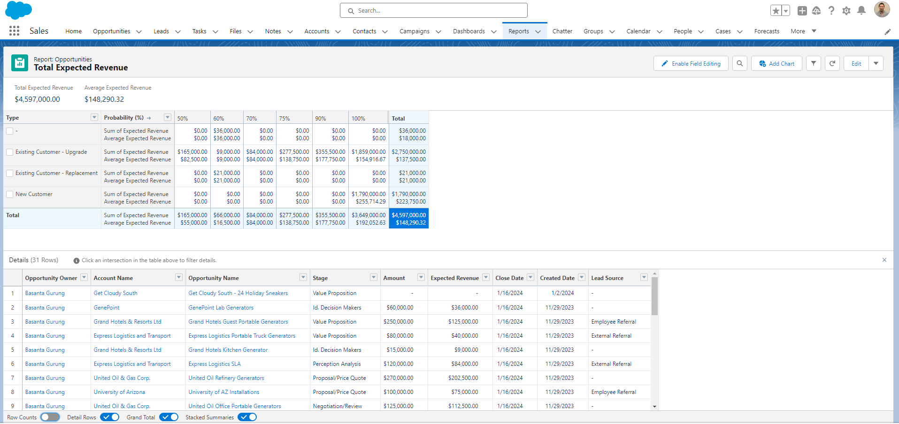
Task 3: Create a Matrix Report
Total and Expected Revenue

Slide 10
Task 4: Business Case Analysis
In a short paragraph on the following slide, describe how using various reports in Salesforce would help SimplySocial make data-driven decisions. In your description, include:
The overall purpose of reports, report filters, and report types
The major steps you took to create various reports
How SimplySocial would benefit from using reports

Slide 11
Task 4: Business Case Analysis
Leveraging various Salesforce reports, SimplySocial can make informed, data-driven decisions.
Different types of reports serve the overall purpose of organizing and presenting data meaningfully, aiding in analysis and decision-making. Utilizing report filters allows SimplySocial to narrow down and focus on specific criteria, tailoring the insights to their unique needs.
Creating different report types, such as tabular, summary, or matrix reports, enables a comprehensive view of data from different angles. The significant steps involve selecting data objects, defining report criteria, and choosing visualization options. SimplySocial benefits by gaining actionable insights, identifying trends, and monitoring key performance indicators, ultimately empowering them to optimize strategies and achieve business objectives.

Slide 12
Task 5: Create a New Report
On the following slide, insert a screenshot of the new report you just created and ran.

Slide 13
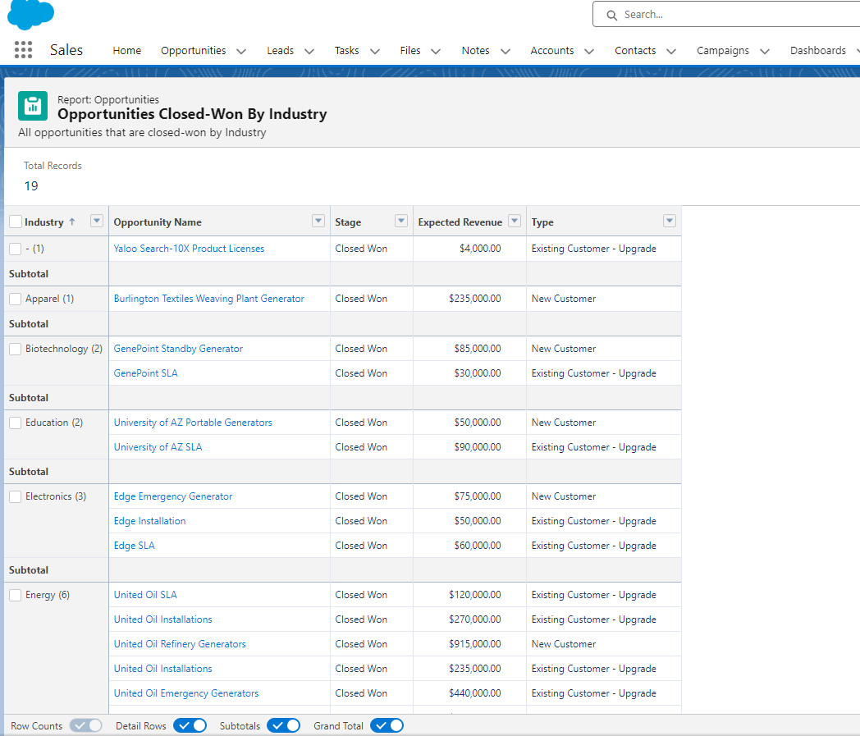
Task 5: Create a New Report
Opportunities Closed-Won Grouped by Industry
Insert Task 5 screenshot here.

Slide 14
Task 6: Create Report Charts
On the following slides, insert screenshots of the charts you just created:
Step 1: All opportunities of all time that have been “Closed — Won” among new customers, with opportunities grouped by industry
Step 2: All leads of all time that are currently “Working — Contacted”, grouped by lead source
Step 3: Expected revenue of all time for open opportunities where probability is >30%

Slide 15
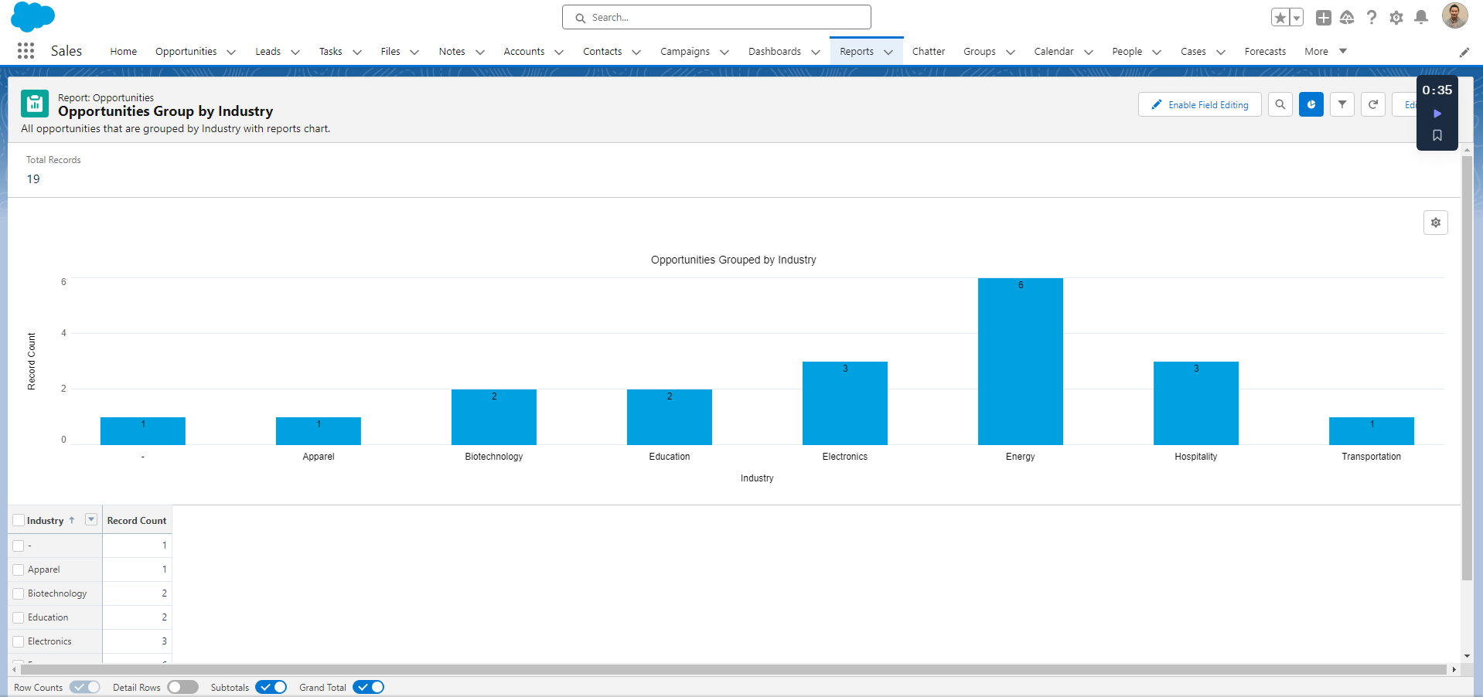
Task 6: Create Report Charts
Opportunities Closed-Won Group By Industry Chart Report
Insert Task 6, Step 1 screenshot here.

Slide 16
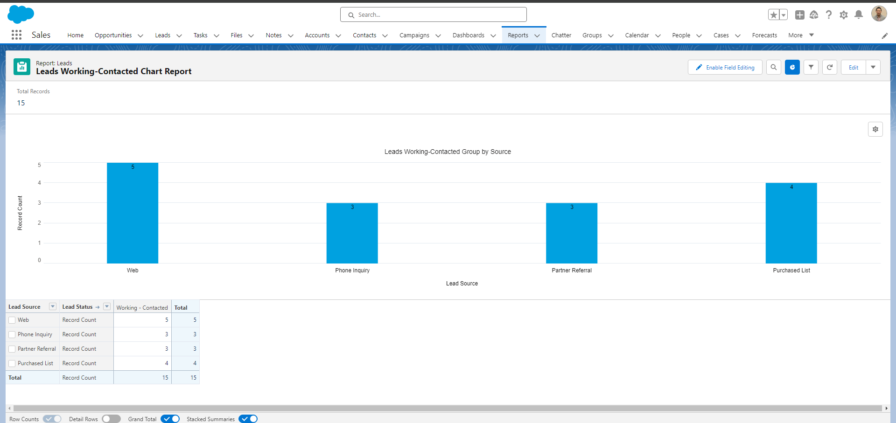
Task 6: Create Report Charts
Insert Task 6, Step 2 screenshot here.
Leads Working-Contacted Report Chart

Slide 17
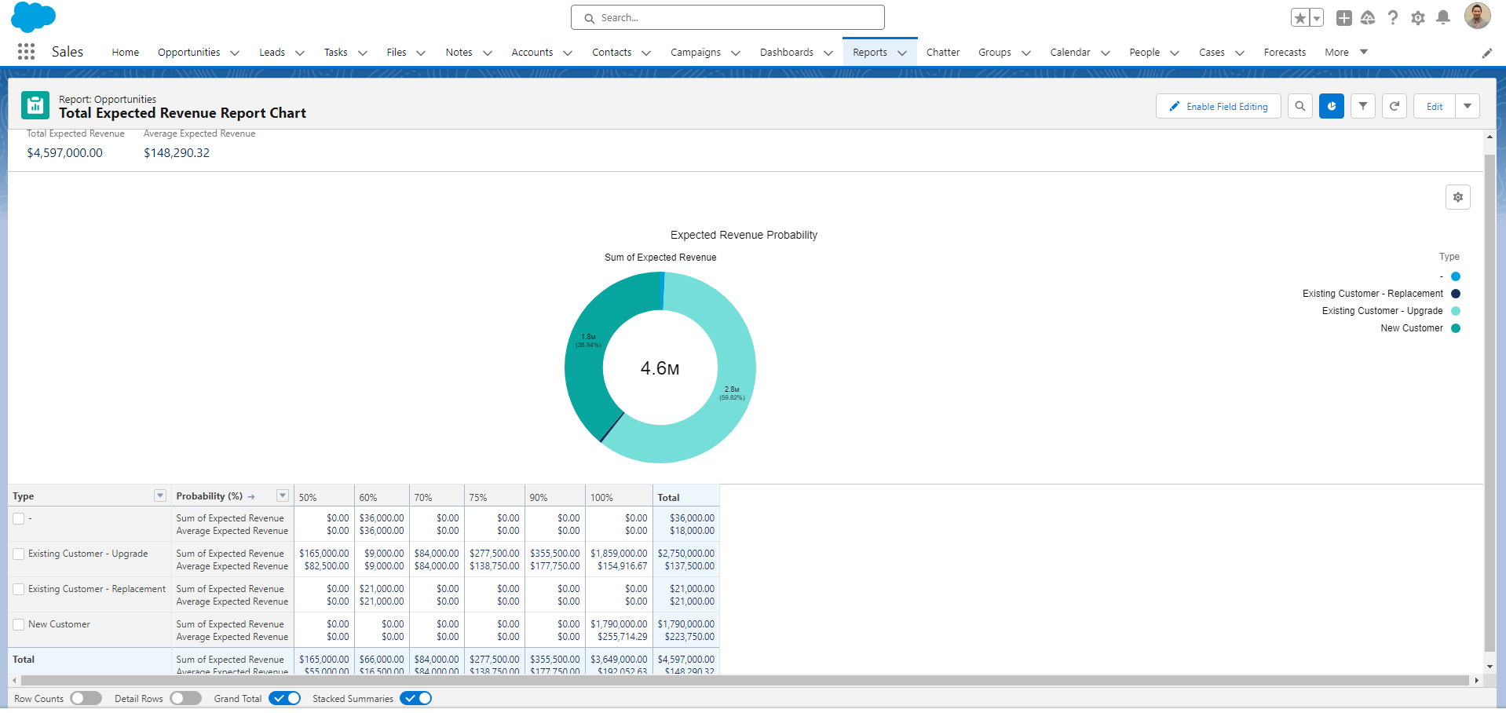
Task 6: Create Report Charts
Expected Revenue > 30%
Insert Task 6, Step 3 screenshot here.

Slide 18
Task 7: Create a Dashboard
On the following slide, insert a screenshot of the dashboard you just created.

Slide 19
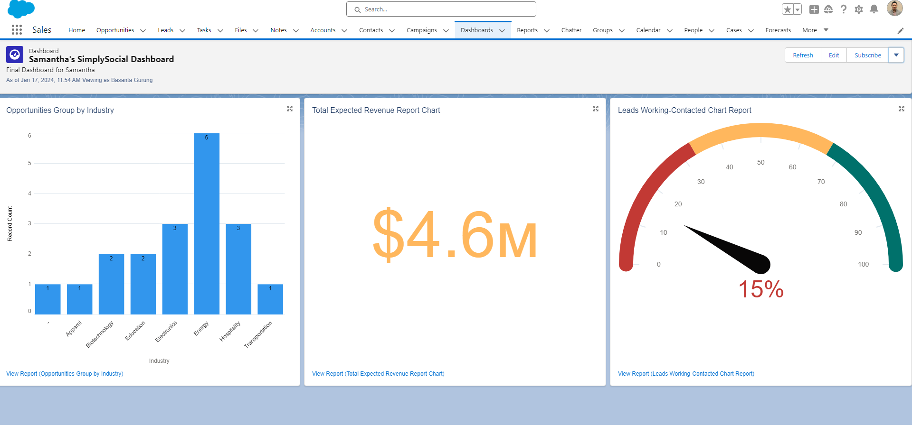
Task 7: Create a Dashboard
SimplySocial Dashboard
Insert Task 7 screenshot here.

Slide 20

You have reached the end of this Project!
This is the end of this Independent Project! Great job completing all these tasks in Salesforce. Make sure you download a copy of this deck for your portfolio.

